Slide 1


W E LC O M E T O M Y P R E S E N TAT I O N
N A M E
: M D . S A N I AT R A H A M A N S E A M
S E R I A L
N O . :
0 1 - 0 3 1 - 0 8
B TAC H
: 0 3 1
C O U R S E
: C O M P U T E R F U N DA M E N TA L S
Employee Payment and Tax Calculation for 'X Industries Ltd.'

Slide 2
Introduction
Objective: Calculate employee payments and taxes
Assign tax status based on tax amount
Methods: Excel Formulas, Conditional formatting,
Charts

Slide 3
Input Data
Employee Data (Sample): - Hourly Rate and Working Hours for 6 employees
Employee Name | Rate/Hour | Working Hour
Hafsa | $15 | 40
Mony | $15 | 45
Habiba | $20 | 50
Khalid | $17 | 36
Mishu | $14 | 40
Maarif | $16 | 35

Slide 4

Total Payment Calculation
Formula
☑ Total Payment = Rate/hour * Working Hours
1
Example
Note
3
2
☑ Similar calculation for all employees
☑ Hafsa: $15 * 40 = $600

Slide 5
Tax Status Determination
Note:
B A S E D O N T H E TA X
C I P : TA X ≥ $ 1 0 0 V I P : TA X ≥ $ 9 0
A M O U N T, E M P L O Y E E S A R E C AT E G O R I Z E D I N T O F O U R S TAT U S E S :
M O D E R AT E : TA X
G E N E R A L : TA X < $ 8 0
≥ $ 8 0
F O R M U L A :
=IF(F4>=100,"CIP",IF(F4>=90,"VIP",IF(F4>=80,"Moderate",IF(F4<80,"General"))))

Slide 6

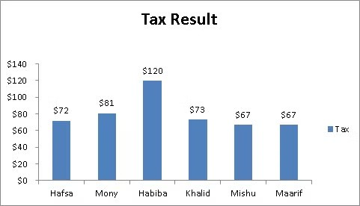
Chart of Tax Results
Bar chart showing tax amounts for each employee (from Excel)

Slide 7

Conditional Formatting
Applied Rules:
CIP
Blue highlight
1
VIP
Yellow highlight
2

Slide 8
Summary of Results
 | Employee Name | Total Payment | Tax (12%) | Tax Status
 | Hafsa | 600 | 72 | General | 8
 | Mony | 900 | 108 | CIP
 | Habiba | 750 | 90 | VIP

Slide 9

Total Payment Calculation
E F F I C I E N C Y I N C A LC U L AT I O N
CIP STATUS
Mony (Tax: $108)
1
VIP STATUS
Habiba (Tax: $90)
Majority
General and Moderate status
3
2

Slide 10


Conclusion
Automated Excel formulas
Simplify payroll management
1
Visual representation
Accurate and e cient calculations Tax and payment calculations
3
2
Helps in identifying high contributors

Slide 11
Thank You
Questions? Thank you for your attention.Any questions?

